Slide 1



網頁設計期末報告
01157061 吳俊威
01157160 陳天龍

Slide 2

1
Mission
Agenda
2
Tehnology Used
Topics Covered
3
Advantage of Website
4
Division of Labor

Slide 3
網站作品的創作動機
MOTIVATION FOR CREATING THE WEBSITE WORK

Slide 4


Slide 5
實際使用之WEB技術
WEB TECHNOLOGY USED IN THIS PROJECT

Slide 6
FRONT-END：
HTML
CSS
JAVASCRIPT
BACK-END:
NODE.JS
DATABASE:
MONGO DB

Slide 7
網站的特色與優點
FUNCTIONALITY AND ADVANTAGE OF WEBSITE

Slide 8
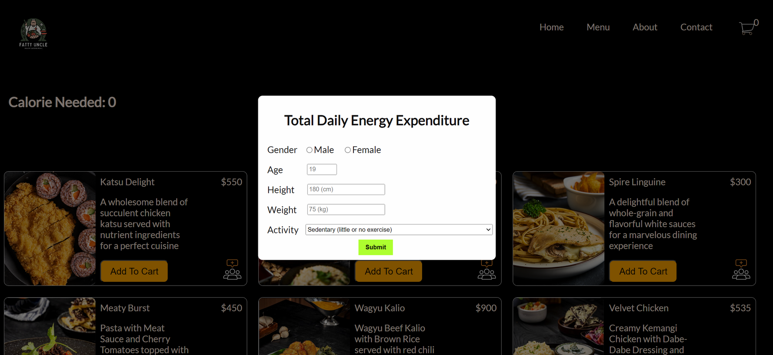
AFTER OPENING THE MENU PAGE, WE WILL PROMPT THE USER TO INPUT THE DATA NEEDED TO CALCULATE THE CALORIE FOR EACH DAY

Slide 9
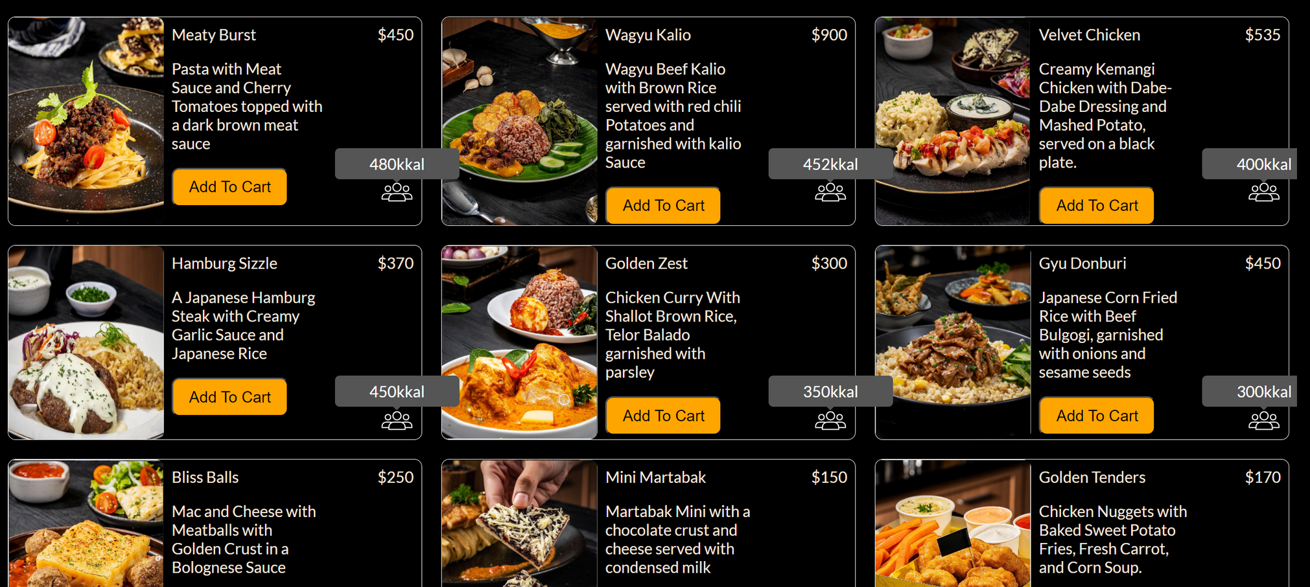
EACH FOOD WILL HAVE ITS OWN CALORIE

Slide 10
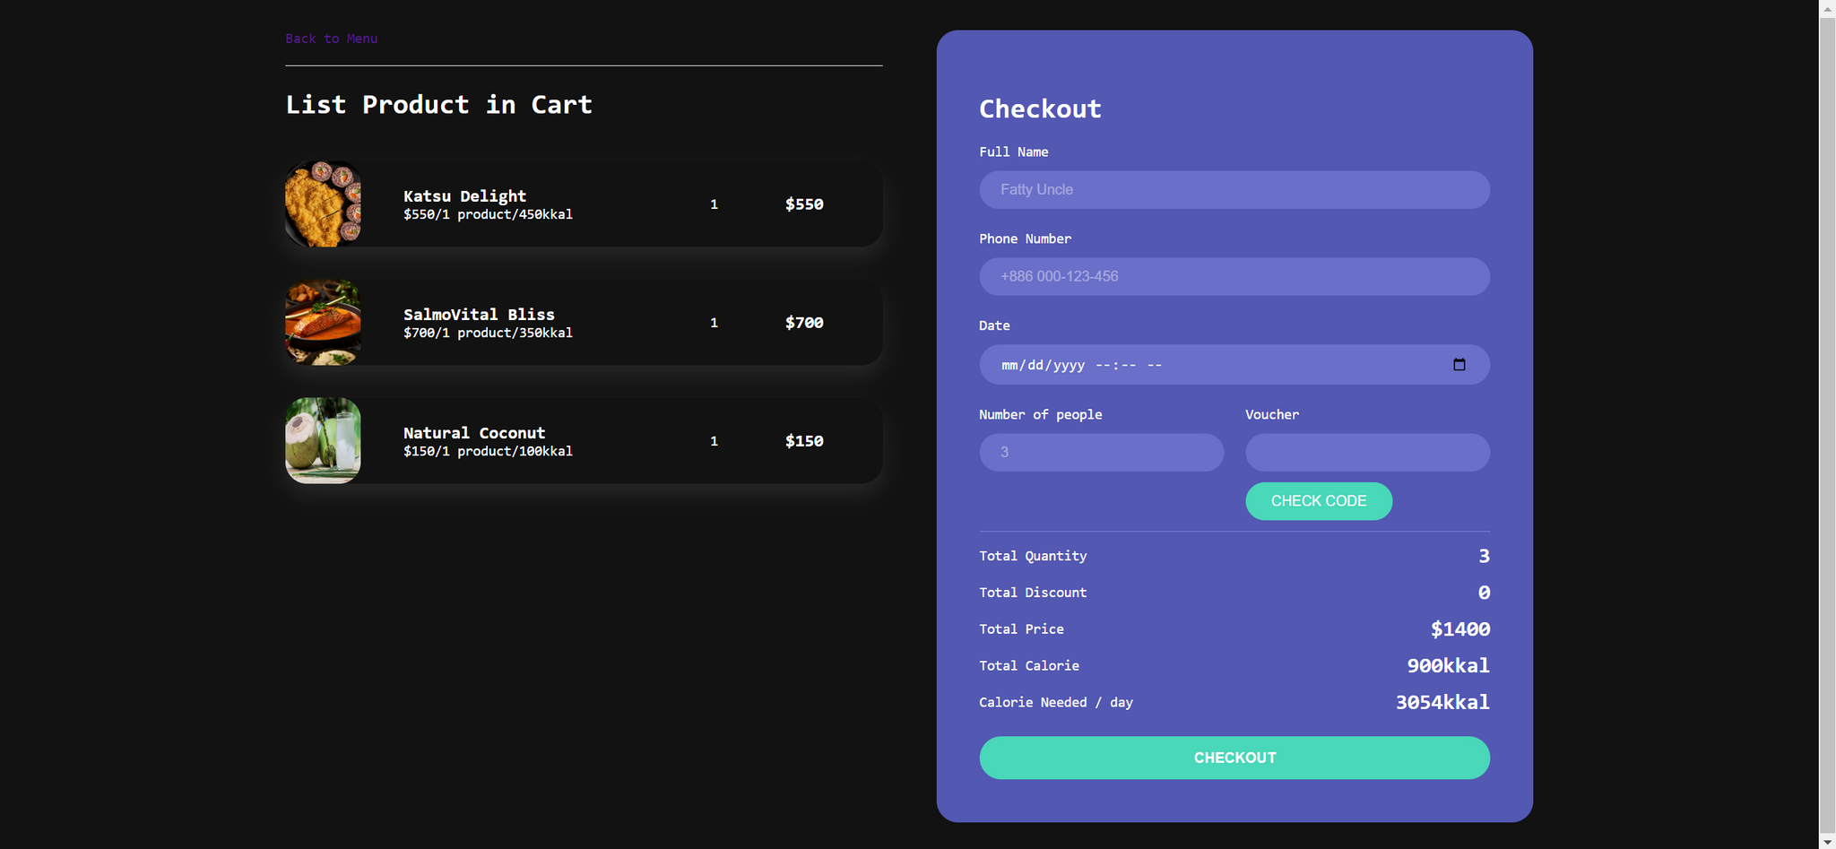
WE ALSO HAVE A ONE-TIME USE VOUCHER IN OUR CHECKOUT

Slide 11
最後實際的分工
DIVISION OF LABOR

Slide 12


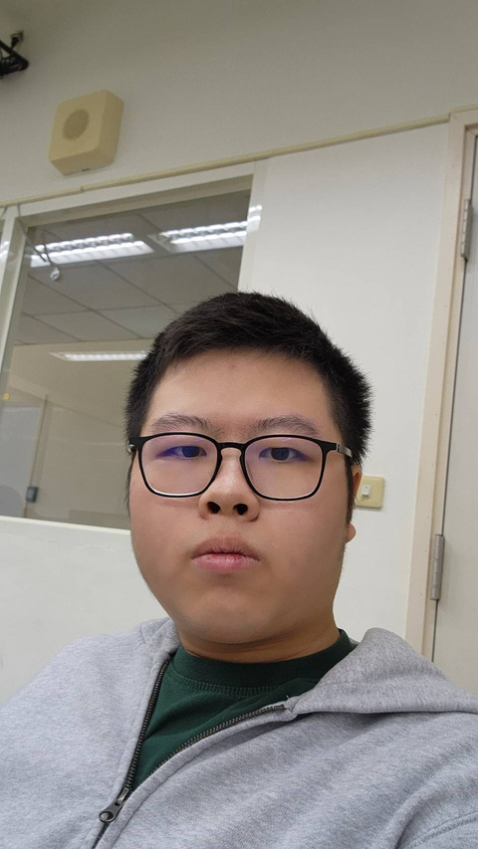
01157061 - 吳俊威:
01157060 - 陳天龍:
HTML
HTML
CSS
CSS
JAVASCRIPT
JAVASCRIPT
ASSETS
MONGODB
NODEJS
NODEJS
ABOUT AND CONTACT
INDEX ，MENU
AND CHECKOUT

Slide 13
GO TO OUR WEBSITE
HTTPS://GEATTT.GITHUB.IO/FINAL-PROJECT/

